Slide 1

ITOF Workshop by Microsoft 2014
Outdoor TOF Imaging
Advance Driver Assistance & Autonomous Vehicle Enabler….
The problem
What's special about our TOF
Images
Summary
  THIS DOCUMENT AND THE INFORMATION CONTANED IN IT ARE PROPRIETARY AND CONFIDENTIAL TO BrightWay Vision LTD.
  NO PERSON OR ENTITY IS ALLOWED TO COPY, REPRINT, REPRODUCE OR PUBLISH ANY PART OF THIS DOCUMENT, NOR DISCLOSE ITS
  CONTENTS TO OTHERS, NOR MAKE ANY USE OF IT, NOR ALLOW OR ASSIST OTHERS TO MAKE ANY USE OF IT - UNLESS BY THE PRIOR
  WRITTEN EXPRESS AUTHORIZATION OF BrightWay Vision AND THEN ONLY TO THE EXTENT AUTHORIZED.
  COPYRIGHT - BrightWay Vision LTD. 2013

Slide 2

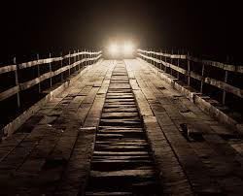
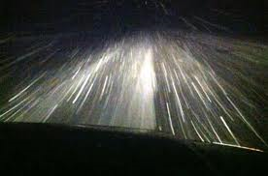
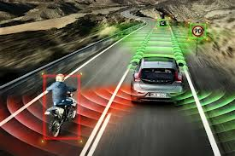
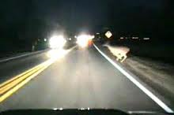
The problem
Blinding
Backscatter
Autonomous
Range

Slide 3

Night Vision Technologies
Active
Near Infra-Red (NIR)
Passive
Long Wave Infra-Red (LWIR)
Continuous Light &
HDR Image Sensor
Pulsed Light &
Gated Image Sensor
Microbolometer
Sensor
Mercedes
LEXUS
BMW
AUDI
BrightEye By
Reflected Image
Emitted Image

Slide 4
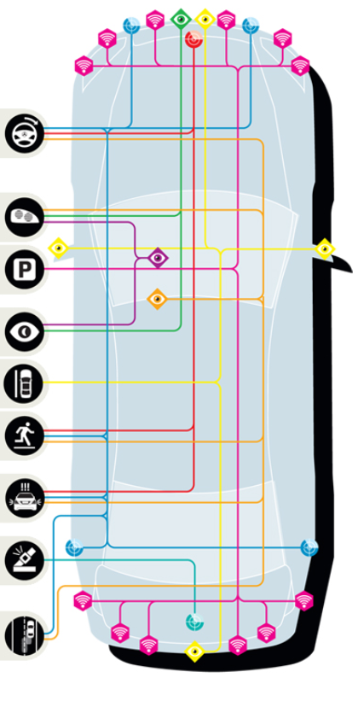
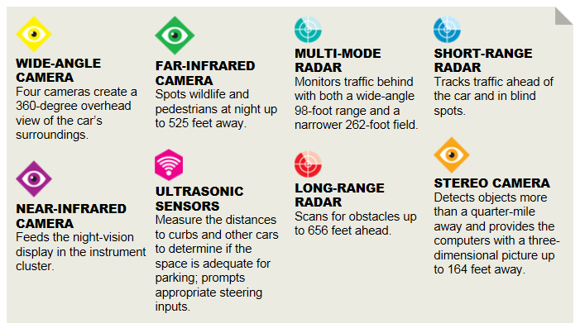
  Problem & Need in Automotive Imaging / Sensing
  # of cameras : 8
  # of different cameras: 4
  # of additional radars: 5
  Limited at night and poor visibility conditions.
  No good cost effective solution for imaging / sensing for autonomous vehicle in all weather scenarios.

Slide 5
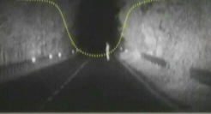

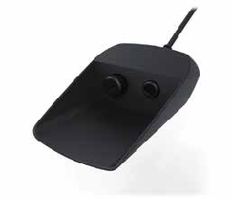
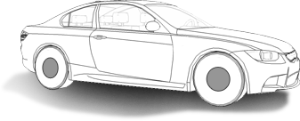

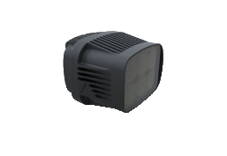
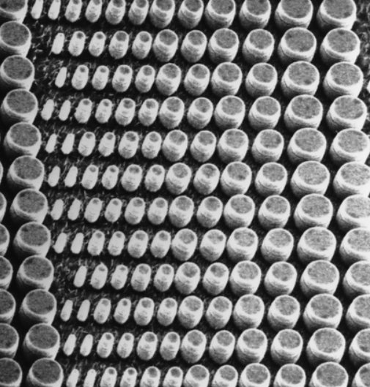
    Technology (Laser Gated Imaging Principal)
Laser and Camera operating in Radar -like mode
Our patented gating technology slices the road image ahead and than combines it to one coherent picture providing optimal detection
Sensor Exposure / Gate Control
75 M
150 M
Laser
Illuminator
(Near Infrared)
Laser pulse
Control
Car
Headlights
250 M

Slide 6
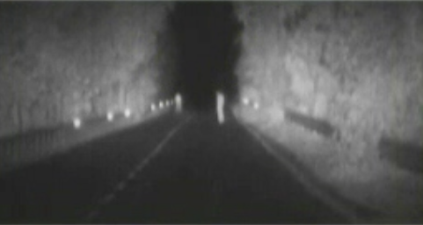
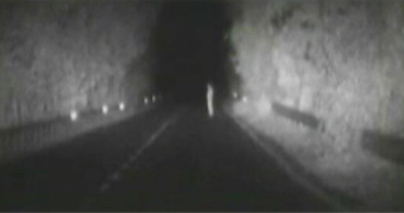
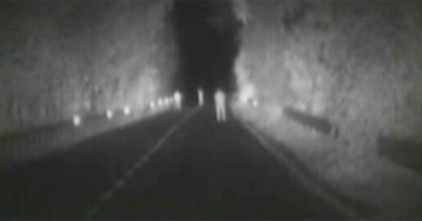
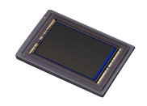
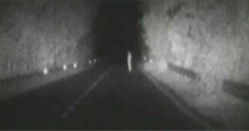
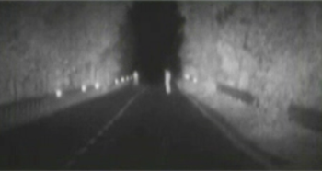
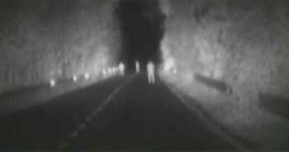
  Multiple sensor exposure
Multiple sensor exposure per a single readout frame
Each exposure may have different timing
Clip

Slide 7

Delta function TOF
On
Laser
Camera
Off
Tl
To
TC
Time
Sensitivity
$$\frac{\text{To}\text{∙}\text{C} }{2}$$
Range

Slide 8

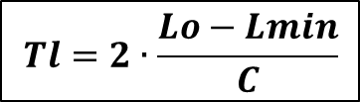
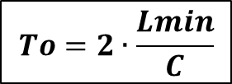
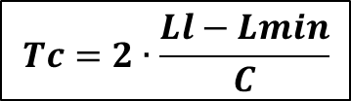

Wide function TOF
On
Laser
$$To=2∙\frac{Lmin}{C}$$
Camera
Off
Tl
To
TC
$$Tl=2∙\frac{Lo−Lmin}{C}$$
Time
Sensitivity
$$Tc=2∙\frac{Ll−Lmin}{C}$$
$$Lmin$$
$$Lo$$
Range

Slide 9






Wide function TOF
On
Laser
Camera
Off
Tl
To
TC
Time
Sensitivity
$$To=2∙\frac{Lmin}{C}$$
$$Tl=2∙\frac{Lo−Lmin}{C}$$
$$Tc=2∙\frac{Ll−Lmin}{C}$$
$$Lmin$$
$$Lo$$
$$Ll$$
Range

Slide 10
Pulse shaping
On
Laser
Camera
Off
Tl
To
TC
Time
Sensitivity
$$To=2∙\frac{Lmin}{C}$$
$$Tl=2∙\frac{Lo−Lmin}{C}$$
$$Tc=2∙\frac{Ll−Lmin}{C}$$
$$Lmin$$
$$Lo$$
$$Ll$$
Range

Slide 11
Range performance - Noise
Range
MTF limit
MTF & Noise limit
Contrast limit
Illuminator limit
Noise limit
Ambient light

Slide 12
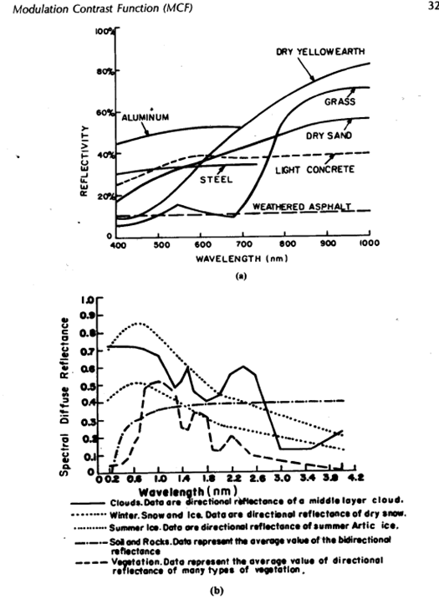
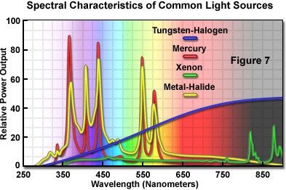
Wavelength advantage

Slide 13
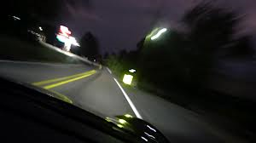
Dynamic range
100m
Range
10000
10m
100
1
10
Pulses
Retro sign
X100 to X1000
Defuse reflection

Slide 14






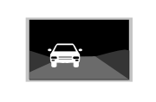
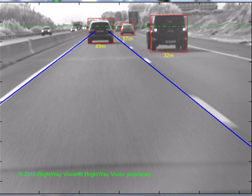
“Night Vision” Solution
  ADAS functions:
  Night image
  (including harsh weather)
  Object detection
  Forward Collision
  Warning (FCW)
  Lane Departure
  Warning (LDW)
    Not blinded by oncoming vehicles.
Natural reflected human vision image

Slide 15
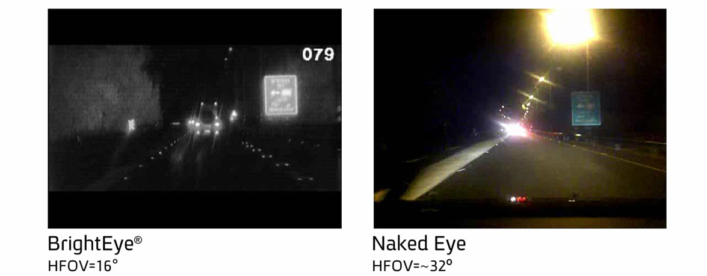
“Night Vision” Solution

Slide 16
Gated Advantage in Obstacle Detection
The gating enables clutter reduction of background at a specific range.
Full depth-of-field
Selectively depth-of-field

Slide 17
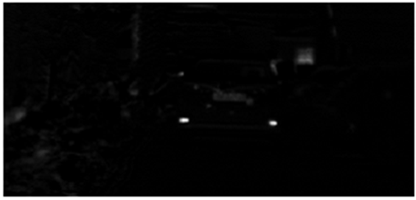
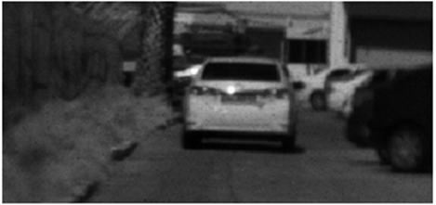
Gated Advantage in FCW
The gating enables retro-reflector detection by removal of background.
Resulting the best preforming FCW in market.
“Removing” the sunlight
Image at day

Slide 18
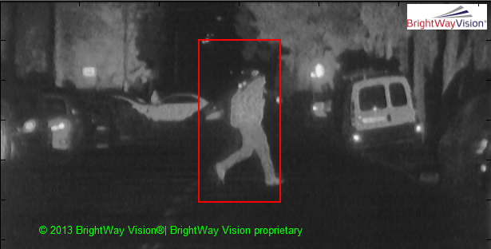

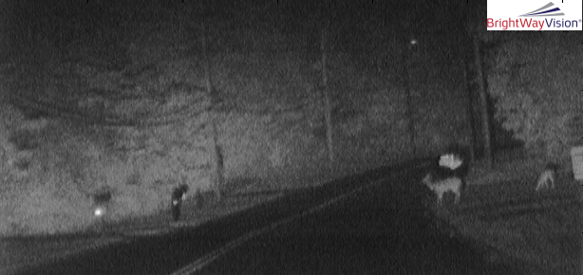
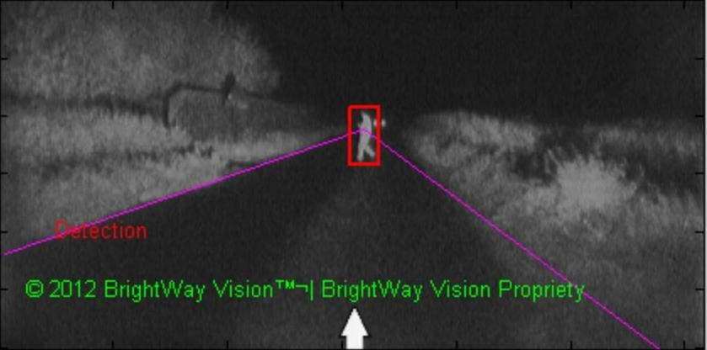
Computer vision
Pedestrian detection in very high clutter and at short ranges.
Pedestrian detection in long ranges.
17

Slide 19
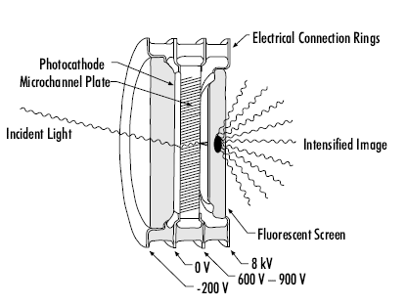
Gated Sensor Comparison
2003-2013
“Analog technology”
Image Intensifier coupled to a CMOS Imager Sensor
2014
Digital technology
Gated CMOS Imager Sensor
Image Intensifier for gating
CMOS Imager Sensor for image
Gated CMOS Imager Sensor for gating & image

Slide 20
Gated Sensor Comparison
Concept System | Gated CMOS Imager Sensor (“GCMOS”) | Parameter
$$$$ | $ | Price | 1
Image Intensifier coupled to CMOS imager | CMOS imager, 0.18μm | Technology | 2
Bloomed Cloud of e⁻ | High anti-blooming ratio →High immunity to retro-reflections | Blooming | 3
Non uniformity “Photon noise” | Uniform Standard CMOS FPN/PRNU (linear) | Noise | 4
Non linear | Linear | Conversion Gain | 5
~10% | >45 % | QE (@800nm) | 6
Only Nighttime | Nighttime & Daytime | Operation conditions | 7
B&W | RCCC or color Bayer | Future growth | 8
Low consumption but with a KV power supply | Similar to existing CMOS imagers, ~300 mwatt | Power consumption | 9
Temperature sensitive | Automotive grade | Environmental | 10
Similar |  | Overall gating performance | 11

Slide 21
Gated CMOS Imager Sensor
Multiple Pulses/Gates per a single readout image frame
RED – Laser Pulse
Blue – Pixel Gate
Signal
e-
e-
e-
e-
e-
e-
e-
e-
e-
e-
e-
e-
e-
e-
e-
e-
e-
e-
e-
e-
e-
e-
e-
e-
Frame Readout
e-
e-
e-
e-
e-
e-
e-
e-
e-
e-
e-
e-
e-
e-
e-
e-
e-
e-
e-
e-
e-
e-
e-
e-
e-
e-
e-
e-
e-
e-
e-
e-
e-
e-
e-
e-
e-
e-
e-
e-
SNR
e-
e-
e-
e-
e-
e-
e-
e-
e-
e-
e-
e-
e-
e-
e-
e-
e-
e-
e-
e-
e-
e-
e-
e-
e-
e-
e-
e-
e-
e-
e-
e-
e-
e-
e-
…
e-
e-
e-
e-
e-
e-
e-
e-
e-
e-
e-
e-
e-
e-
e-
e-
T_{frame}
t
e-
Signal
Noise
e-
e-

Slide 22
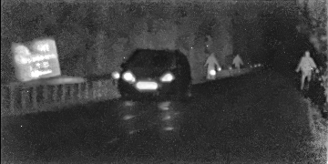
Gated CMOS Imager Sensor (GCMOS)
  Fully CMOS compatible
  Multi Gate in a frame (accumulation mode or flash mode)
  Resolution: 1280X960
Gated CMOS Test Chip Imagery
(360 X 180)
Retro-reflector 50m
200m
150m
100m
Vehicle
(Low Beams ) 70m
Raw data (no FPN correction, integration etc.)
21

Slide 23


Technology road map
“Day / Night & 3D information”
Technology: Multi-Sensing & Ranging Gated Imaging
2018
“Day / Night Vision”
Technology: Multi-Sensing Gated Imaging
2016
“Night Vision & Harsh Weather”
Technology: Near Infrared Gated Imaging
2014
BrightEyeTM
a camera based - ADAS enabler for multiple functions maintained at all weather and light conditions

Slide 24
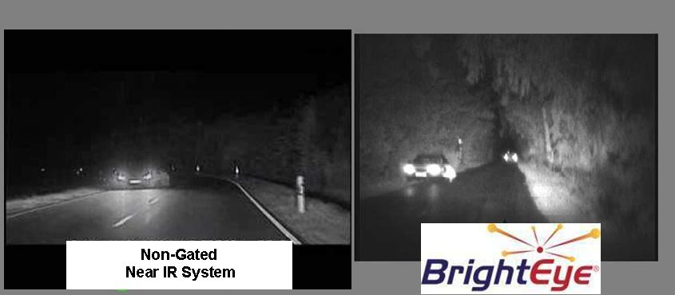
Active gated imaging vs. non-gated imaging
Human recognition difficult due to blooming
Limited Depth-of-field
Human clearly recognizable
Keeping whole Depth-of-field
No Blooming
~250m
~50m
~50m

Slide 25
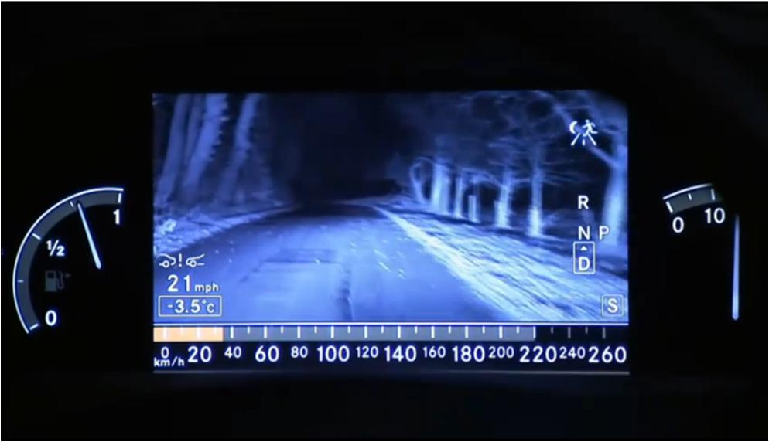
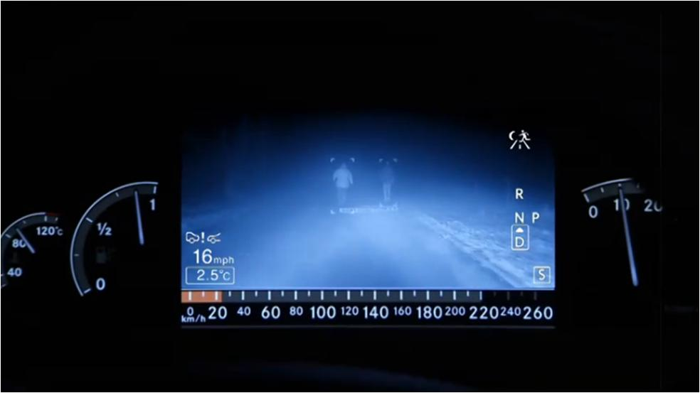
Active gated imaging vs. non-gated imaging
Intensity and backscatter

Slide 26
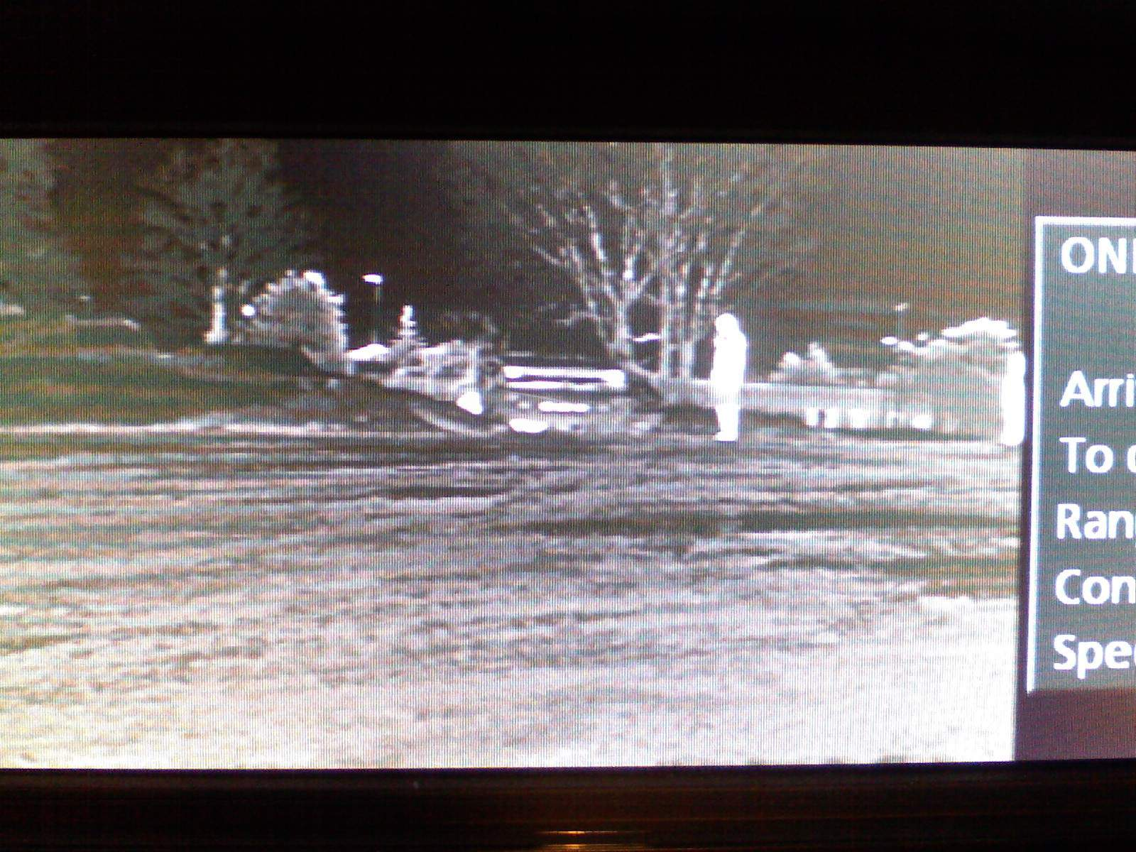
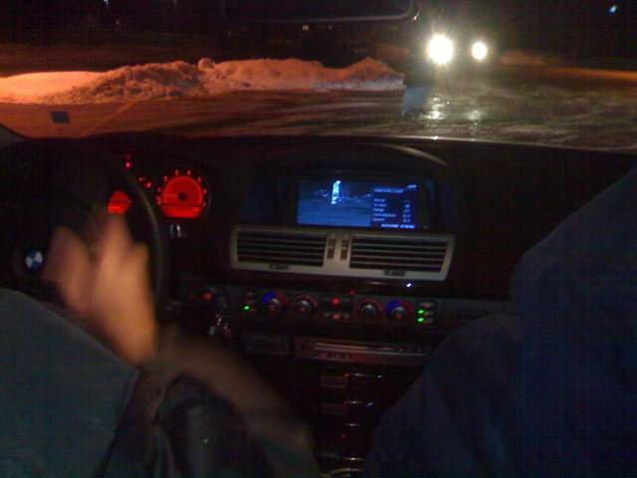
Active gated imaging vs. LWIR
Pedestrian is seen easily
Vehicle (just out of parking, still cold) is barely visible
When looking through windshield, driver is blinded by on-coming vehicle, pedestrian is barely visible
When looking on the Night Vision Display, only pedestrian is visible

Slide 27
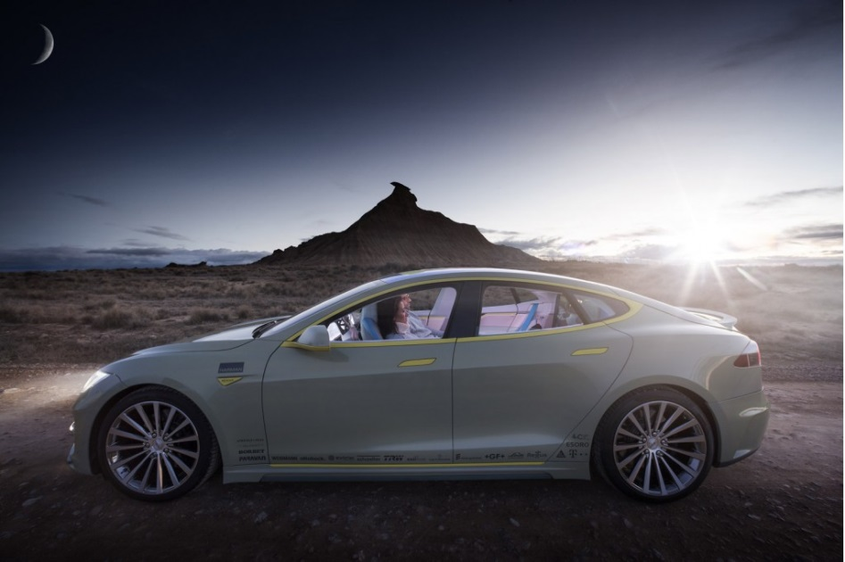
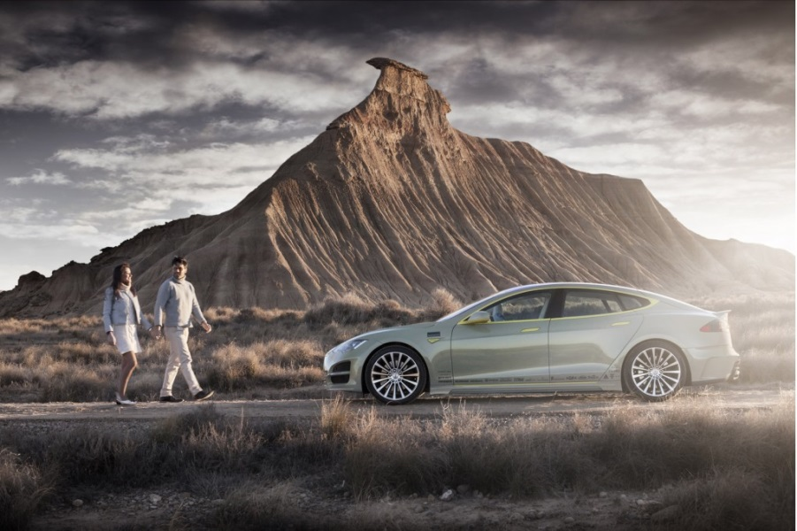
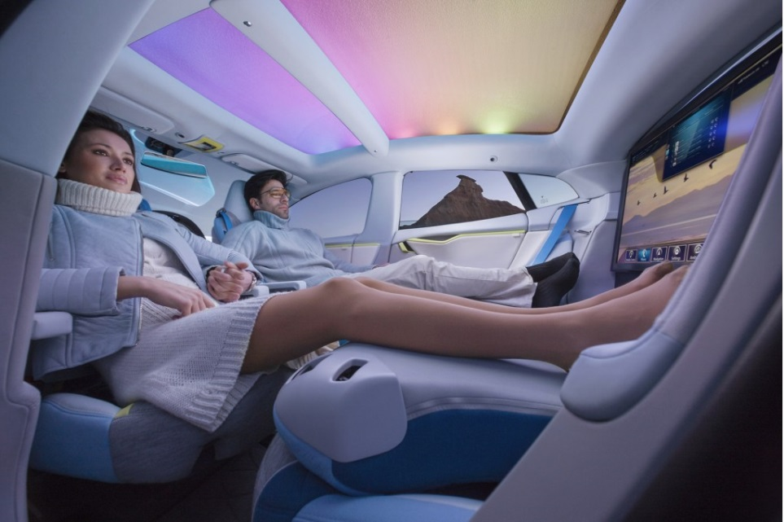
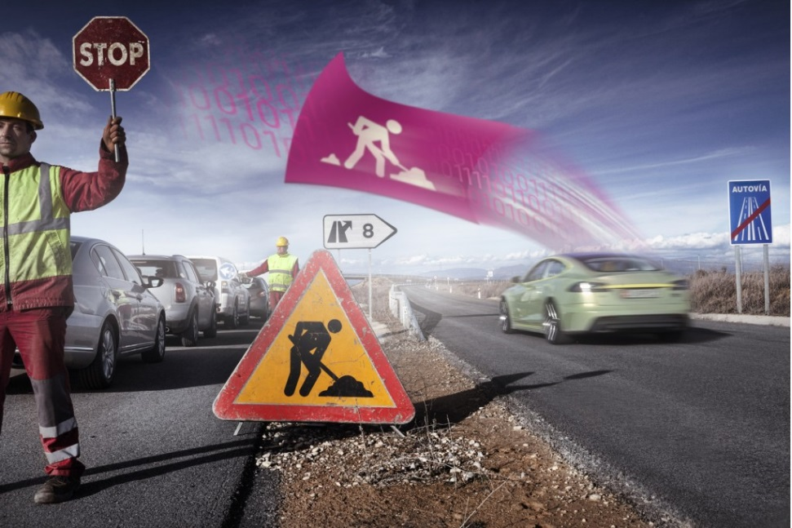
2025

